Slide 1
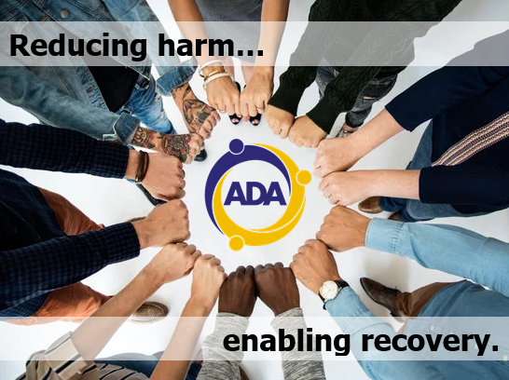

REDUCING HARM ENABLING RECOVERY

Slide 2

NEED
WHAT IS THE PROBLEM
THAT WE ARE TRYING TO ADDRESS?
25% Men
18% Women
within Scotland are drinking above the recommended safe levels which will result in long term health effects

Slide 3

NEED
WHAT IS THE PROBLEM
THAT WE ARE TRYING TO ADDRESS?
In Aberdeen City alone the overall calculated cost of alcohol harm is
£120.92 million per year
(this includes health, social services, reduced productivity and crime), resulting in an overall cost of
£557 per head

Slide 4

NEED
WHAT IS THE PROBLEM
THAT WE ARE TRYING TO ADDRESS?
In Scotland, an estimated
1.7 million
working days
are estimated to be lost each year by people missing work due to the effects of alcohol

Slide 5

NEED
WHAT IS THE PROBLEM
THAT WE ARE TRYING TO ADDRESS?
6% of the adult population in Scotland reported taking an illicit substance within the last year (2014/15)
with Cannabis (5%) being the most commonly reported drug used

Slide 6
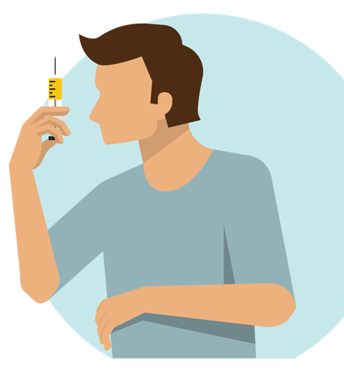
NEED
WHAT IS THE PROBLEM
THAT WE ARE TRYING TO ADDRESS?
It is estimated that around
3,100 people
in Aberdeen are using substances such as heroin and benzodiazepines problematically (2016)

Slide 7
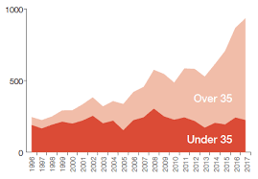

NEED
WHAT IS THE PROBLEM
THAT WE ARE TRYING TO ADDRESS?
There were drug related
934
85
deaths in Scotland last year,
deaths took place in Grampian with
54 of these within Aberdeen City, which has the fourth highest death rate in Scotland. Drug Deaths have been rising year on year. All are unnecessary and totally preventable

Slide 8

NEED
WHAT IS THE PROBLEM
THAT WE ARE TRYING TO ADDRESS?
The full estimated impact on health, social, family and communities costs of drug use is
£3.5 billion
per annum in Scotland

Slide 9

ACTIVITIES
WHAT ARE WE DOING
TO ADDRESS THIS?
Established in 1986, ADA has developed effective services to respond to emerging local substance use issues
Our services improve the quality of life of individuals, families and communities by educating people to prevent harms occurring, helping people reduce harms and promote recovery throughout the North East
Our local knowledge, expertise and credibility along with our diverse partnerships, enables us to enhance our positive impact for service users
We deliver immediate access to services via our 7 day a week service where advice and support is given, and then referrals to other parts of the service for more in depth work as required

Slide 10
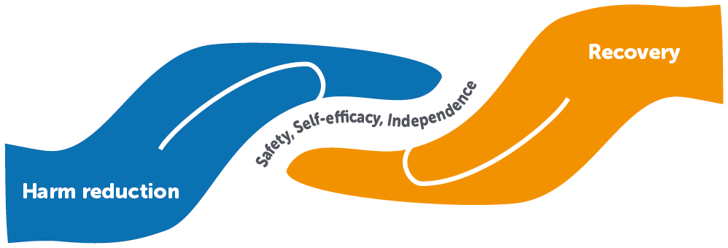
ACTIVITIES
WHAT ARE WE DOING
TO ADDRESS THIS?
The focus of our work is on:
Preventing and Reducing Harm and;
Enabling Recovery
Achieved by creating ease of access to a confidential service across Aberdeen City and Central and South Aberdeenshire

Slide 11

OUTCOMES
WHAT ARE THE RESULTS
OF THESE ACTIONS?
1,700
Individuals engaged across
all of our services during
2018/2019

Slide 12

EVIDENCE
HOW DO WE KNOW WE HAVE MADE A DIFFERENCE?
Our Annual Recovery Star Award Ceremony!
Held to recognise the full variety of achievements and milestones individuals have reached in their recovery from problematic drug and/or alcohol use. It also recognises volunteers and staff who have contributed towards the achievements of others. In 2017/18 nearly 200 individuals collected an award.
The Award Categories are:
Supporting Others (the investment and effort in supporting another)
Groups & Activities (a group or activity with significant special impact)
Achieving Personal Milestones (overcoming personal barriers, challenges and adversity to make progress)
Educational & Training Achievements (achievements in areas of formal education and training)
Special Recognition (anyone who has gone ‘above and beyond’ expectation in supporting others)

Slide 13

EVIDENCE
HOW DO WE KNOW WE HAVE
MADE A DIFFERENCE?
Alec’s Story
I had been a heavy drinker since I was young and had also tried a variety of drugs including gear (heroin). My dad was a heavy drinker. My increased drinking and heroin use was affecting every part of my life; my wife was going to leave me and was spending all my money on drink and drugs, my health was poor and I was getting arrested on a regular basis. I went to my GP for help and she told me about ADA. I called the helpline and was able to see a duty worker for 1:1 through their drop in later that day.
My goal was to completely stop using gear and to reduce my drinking.
My worker gave me lots of support initially through 1:1 meetings as well as encouraging me to attend SMART Recovery meetings. Through the 1:1 support and the meetings I was able to cut down then stop using gear, firstly by getting on a script and then by cutting down my drinking.

Slide 14
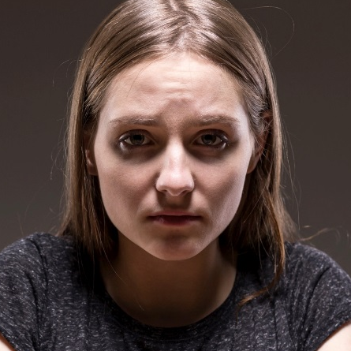
EVIDENCE
HOW DO WE KNOW WE HAVE
MADE A DIFFERENCE?
Alison’s Story
I was referred to ADA by my nurse at the Integrated Alcohol Service. At that time I was drinking heavily and becoming physically unwell. I had lost my job due to my drinking and I was at risk of losing my home due to financial problems. My worker helped me set goals and plan a reduction so that I could have an outpatient detox.
I have now been sober for three months.
My worker also supported me to access financial advice which stopped me from being evicted from my home. Although I have been sober for three months my worker still supports me with relapse prevention. ADA then introduced me to DART, through this my confidence has grown and I have learned how to manage my emotions without having to drink to numb them. I also began attending SMART meetings and get a lot of support from my peers.

Slide 15

FEEDBACK
“I was prompted to take my brother to the ADA drop in centre on Hadden Street.
My brother has been battling alcoholism for quite a few years now. Luckily he has managed to retain his job although he has had to accept demotion and less pay. He contacted me last week as he needed cash to buy Vodka and cigarettes. I told him I would only help him for one last time if he committed to get help.
Long story short - I took him in last Friday, we were amazed that a counselor (Kirsty I think) ushered us straight into a room and spent an hour getting to know my brother and making a couple of calls to support him. He has been back twice. They promised to ring him this week and they did as promised.
It's a fantastic service, well out of sight of most people. My brother is now back at work, drinking far
less and is scared but determined to give up. The support from ADA has been outstanding. I just wanted
to let you have the feedback and thank you for the very timely sending through of your bulletin.
Keep up the great work.”
John
Family Member

Slide 16
FEEDBACK
“Great support available to get your life back on the right road and guidance to all the help you can get, very valuable.”
“I feel that I am greatly supported in my 1-1 session. My worker is very knowledgeable while treating me with respect as an individual. Group sessions are also great in meeting others in similar circumstances and working collectively to achieve our goals.”
“I did new things with my time (gardening group and SMART) and I have learned to put myself and my recovery first. Before I felt I had to do things for my family and ex-partner but I realised they were demanding on my time and this was not good for my recovery.”

Slide 17


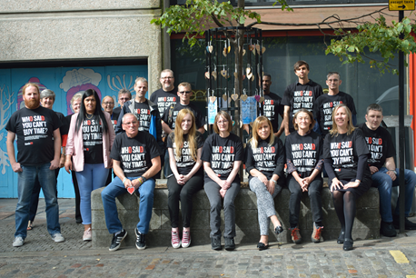
Sponsorship and Donations
As a not-for-profit organisation, Alcohol & Drugs Action (in order to develop and keep providing top quality services through innovation and flexibility), are grateful to receive sponsorship for its activities. This includes its annual Recovery Star Awards, as well as general donations to support activities that directly benefit its service users.
REDUCING HARM ENABLING RECOVERY

Slide 18


To get in touch
Please Contact Us at:
Alcohol & Drugs Action (ADA)
7 Hadden Street
Aberdeen AB11 6NU
Helpline: 01224 594700
Business Support: 01224 577120
E-mail: info@alcoholanddrugsaction.org.uk
www.alcoholanddrugsaction.co.uk
REDUCING HARM ENABLING RECOVERY

